Slide 1

Carpool Maps and Guidelines
For the safety and well being of our students, faculty, and surrounding community please read and follow the carpool rules carefully.
PLEASE……
Obey all traffic and speed limit signs. The school is surrounded by a residential neighborhood and keeping all parties safe is paramount.
NO CELL PHONES IN CARPOOL LINE (hang up the phone and stay alert).
Obey all faculty instruction and direction. On occasion the carpool flow may change so it is very important to pay attention to the faculty directing carpool.
Please remain in your vehicle.
Morning drop off: In the mornings, all cars are to drive onto the back parking lot from the Woodmont Rd. entrance. Parents are to pull all
the way down to the lower church parking lot. Students are to exit their cars and go to their class line. Parents pulling off the playground are to exit by
the front of St. Edward the Confessor Church. In the morning, all cars are to maintain a single file line. All pre-school and kindergarten children will be
escorted into the building by safety patrols. All other students, weather permitting, will remain outside until the 8:15 bell. On inclement weather days,
parents are to pull up to the back of the school main doors, and children in grades 1-8 go to the cafeteria.
Afternoon pick-up: The afternoon dismissal procedure begins at 2:55. Bus riders in grades 1-3 will exit through the front
door of FHH to board the buses. Students in grades 4-8 will exit through the main front door of the school to board buses. Single car riders will exit
through the main rear doors of the school to be walked over to the lower parking lot by the church for dismissal. (Parents are asked to remain in their
cars at all times.) Day Care students will go to the cafeteria for their afternoon snacks. Supervision for car riders is until 3:15 pm. If students are not
picked up by then, and there is no emergency, students will be sent to Day Care, and parents will be charged an occasional rate.
PLEASE BE KIND TO OUR SCHOOL NEIGHBORS AND DO NOT SPEED THROUGH THE NEIGHBORHOOD

Slide 2
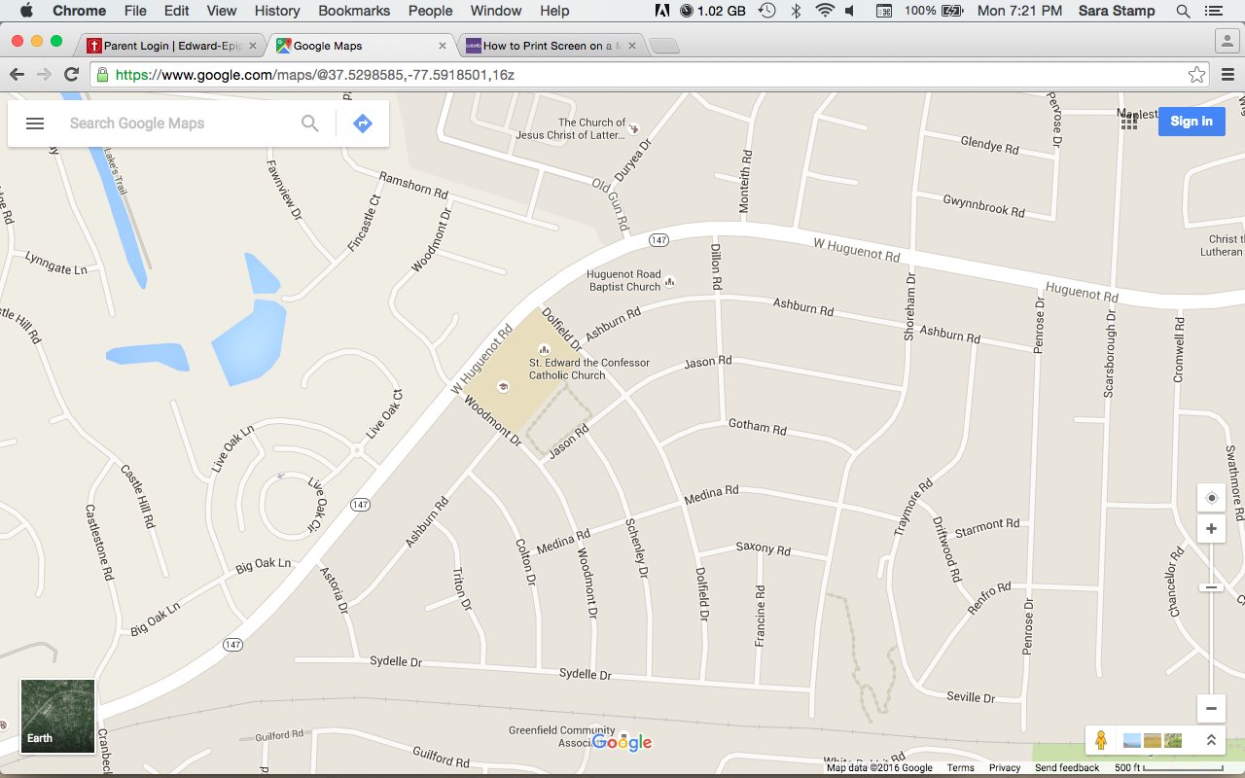

Directions to Approach and Enter the School Campus from Huguenot Road
Going North (coming from Robious Road) on Huguenot Road turn right onto Astoria Road, left onto Sydelle Drive, left onto Woodmont Drive and then right into the back parking lot of the school. Going South (coming from Bon Air) on Huguenot Road, turn left onto Dolfield Road, right onto Jason Road, right onto Woodmont Drive and then right into the back parking lot of the school. This applies to drop-off and pick-up.
Drop off begins
At 7:55 a.m.
Do not turn onto
Woodmont Dr from
Huguenot Rd.
No left turn into
the back
parking lot from
Woodmont Drive
for carpool.
Exit by the front
of St. Edward the
Confessor Church
(obey the stop sign).
W Huguenot Rd

Slide 3
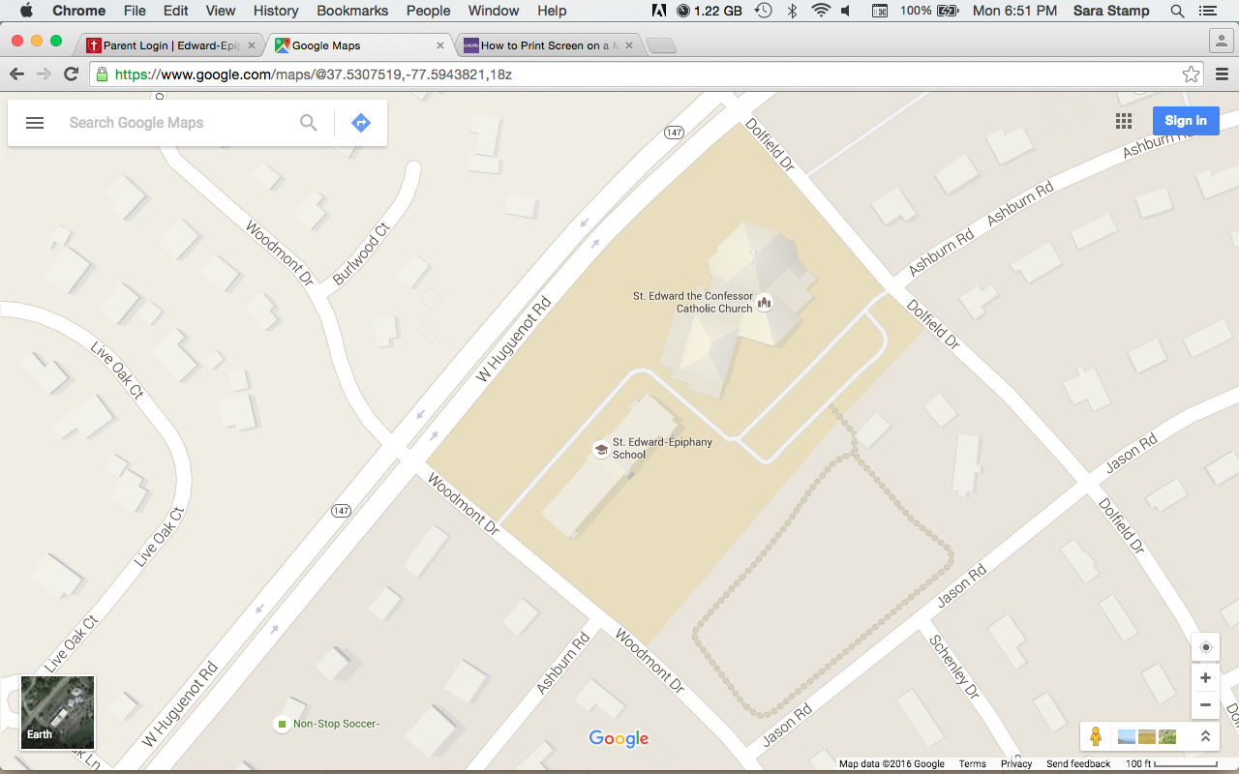
Rear Parking Lot Instructions - Morning Drop Off
Turn right into the back parking lot. Stay to the far right of the parking lot along the athletic field in a single car line. If you are first, pull to where the line is on the map. Exit by the front of St. Edward the Confessor Church and make sure to obey the stop sign at Dolfield Road.
Exit
(obey stop sign)
Drop off begins
At 7:55 a.m.
Do not turn onto
Woodmont Dr from
Huguenot Rd.
No left turn into
the back
parking lot from
Woodmont Drive
for carpool.
Exit by the front
of St. Edward the
Confessor Church
(obey the stop sign).
Enter

Slide 4
Rear Parking Lot Instructions – Inclement Weather Morning Drop Off
Turn right into the back parking lot. Stay to the far left of the parking lot along the school in a single car line. If you are at the front, pull to where the line is on the map. Exit by the front of St. Edward the Confessor Church and make sure to obey the stop sign at Dolfield Road.
Drop off begins
At 7:55 a.m.
Do not turn onto
Woodmont Dr from
Huguenot Rd.
No left turn into
the back
parking lot from
Woodmont Drive
for carpool.
Exit by the front
of St. Edward the
Confessor Church
(obey the stop sign).
Exit
(obey stop sign)
Enter

Slide 5
Rear Parking Lot Instructions - Afternoon Pick-Up (MULTI-RIDER)
Turn right into the back parking lot. If you are at the front, pull to where the line is on the map. Multi-rider pick-up stays to the far left of the parking lot along the back of the school in single car lines stacked side by side with hoods facing the rear of the school (see detail below).
The afternoon dismissal procedure begins at 2:55pm.
No left turn into the back
parking lot from Woodmont Drive.
Exit by the front of St. Edward the Confessor Church.
Supervision for car riders is until 3:15 pm.
Bus riders in grades 1-3 will exit through the front door of FHH to board the buses.
Students in grades 4-8 will exit through the main front door of the school to board buses.
Exit
(obey stop sign)
Single-rider
Pick-up
1
2
3
7
4
8
5
9
Multi-rider
Pick-up
6

Slide 6
Rear Parking Lot Instructions - Afternoon Pick-Up (SINGLES)
Turn right into the back parking lot. If you are at the front, pull to where the line is on the map. Single rider pick-ups should pull up in three lines to the lower parking lot by the church in front of the Grove (see detail below).
The afternoon dismissal procedure begins at 2:55pm.
No left turn into the back
parking lot from Woodmont Drive.
Exit by the front of St. Edward the Confessor Church.
Supervision for car riders is until 3:15 pm.
Bus riders in grades 1-3 will exit through the front door of FHH to board the buses.
Students in grades 4-8 will exit through the main front door of the school to board buses.
Exit
(obey stop sign)
Single-rider
Pick-up
Multi-rider
Pick-up

Slide 7
Rear Parking Lot Instructions - Afternoon Pic-Up in Inclement Weather
Turn right into the back parking lot. Multi-rider pick-up stays to the far left of the parking lot along the back of the school in single car lines stacked side by side with hoods facing the rear of the school (see detail below). In the event of inclement weather, car pool cars should pull around to the front of the school and exit onto Woodmont Road. Single rider pick-ups should pull up to the upper parking lot of the church along side the gym to pick up students and the exit to Dolfield Road. If you are at the front, pull to the respective line.
The afternoon dismissal procedure begins at 2:55pm.
No left turn into the back
parking lot from Woodmont Drive.
Exit by the front of St. Edward the Confessor Church.
Supervision for car riders is until 3:15 pm.
Bus riders in grades 1-3 will exit through the front door of FHH to board the buses.
Students in grades 4-8 will exit through the main front door of the school to board buses.
Buses will depart before car pool commences.
Exit
(obey stop sign)
Bus Riders
Single-rider
Pick-up
Exit
Multi-rider
Pick-up

Slide 8
Pick-Up for Preschool Students Departing at Noon
Pre-School pick-up
begins at noon in
front of the school.
If you are at the front, pull to the line.
Students will be
escorted from the entrance of
Father Herbert Hall
to their vehicles.
Exit by the front of
St. Edward the
Confessor Church.
Exit
(obey stop sign)
Pick-Up

